Slide 1
caB2B – Design Specifications 2.0
16th October, 2006

Slide 2
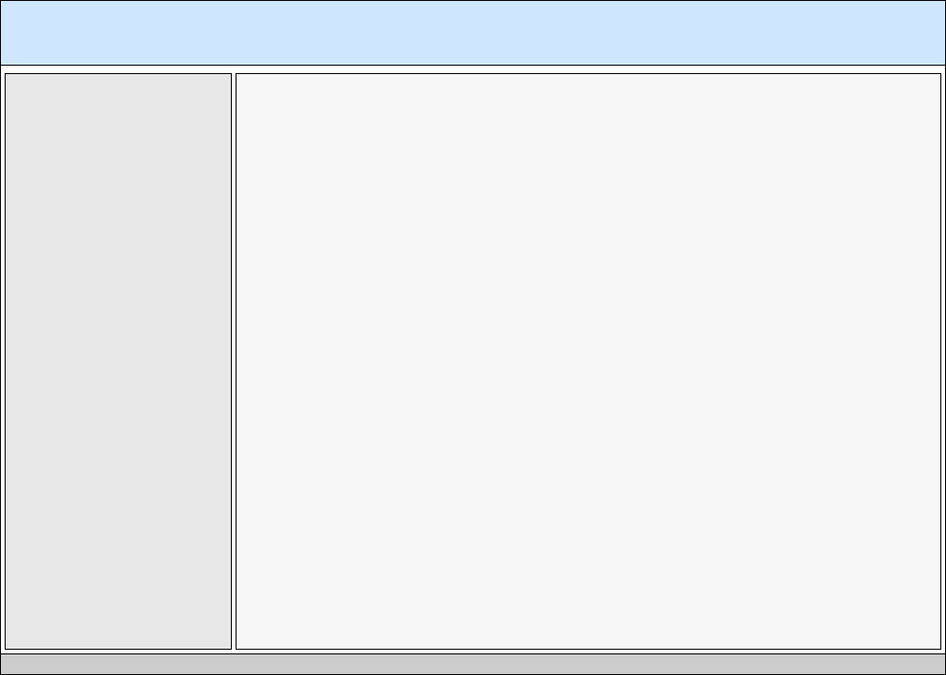
caB2B Application High Level Grid Layout
(Target Resolution 1024 X 768 pixels)
70 Pixels (Fixed)
Global Navigation
8 Pixels
(Fixed)
242 Pixels (Minimum & Expandable)
752 Pixels (Expandable)
712 Pixels
Left Navigation
(Expandable Tabs)
Content
1008 Pixels
25 Pixels
(Fixed)
Status Bar
4 Pixels
(Fixed)
4 Pixels
(Fixed)
4 Pixels (Fixed)
4 Pixels
(Fixed)

Slide 3
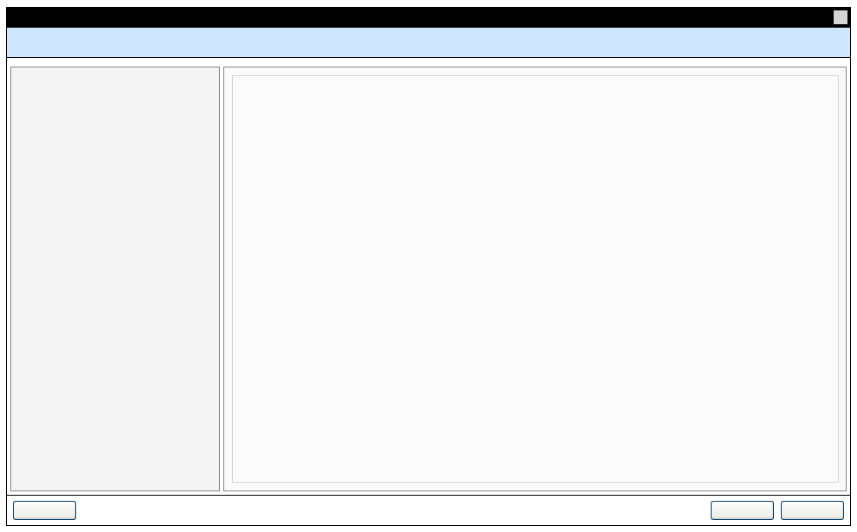
‘Search Data’ Wizard (Size1)
16 X 16 Pixel Icon
976 Pixels
(Fixed)
20 Pixels
(Fixed)
Wizard Title
36 Pixels
(Fixed)
Wizard Navigation
8 Pixels
(Fixed)
242 Pixels (Minimum & Expandable)
580 Pixels
(Fixed)
Left Navigation
(Expandable Tabs if
required)
36 Pixels
(Fixed)
8 Pixels
(Fixed)
8 Pixels
(Fixed)
8 Pixels
(Fixed)

Slide 4
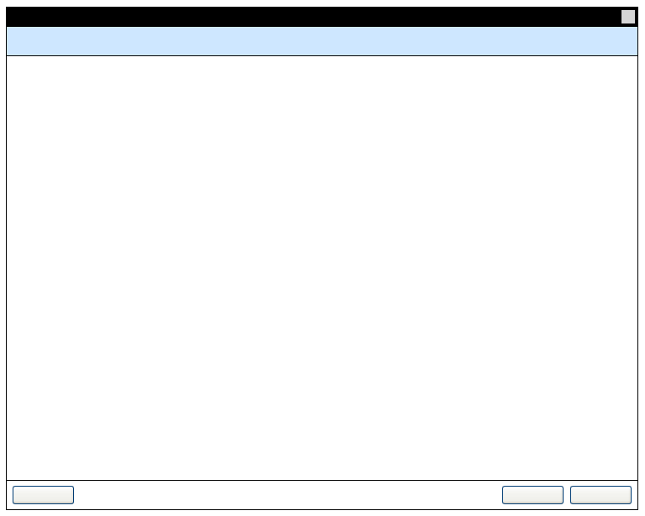
Wizard (Size 2)
16 X 16 Pixel Icon
752Pixels
(Fixed)
20 Pixels
(Fixed)
Wizard Title
36 Pixels
(Fixed)
580 Pixels
(Fixed)
36 Pixels
(Fixed)
8 Pixels
(Fixed)
8 Pixels
(Fixed)
8 Pixels
(Fixed)

Slide 5
Font specifications
Application elements | Font size | Color | Background
Wizard Title | Arial 11pt bold | # FFFFFF | #000000
Wizard Navigation Links | Arial 10pt Bold | # 000000
Wizard Navigation Links (Active) | Arial 10pt Bold | # 006699
Body Text (for the entire application) | Arial 10pt Normal | #000000
Hyper Links Text (for the entire application) | Arial 9pt Bold Underlined | # 006699
Alignment (for the entire application) | Left
Text indentation (for the entire application) | Top: 10 pixels Left: 10 pixels
Button specifications
Attribute | Value
Action Button size | Height: 22 Pixels Width: 70 Pixels or if more width is required then 5 pixel left-right spacing
Action Button Label Font | Arial 10pt Normal ( #000000 )
Spacing between buttons | 8 Pixels

Slide 6
Global Navigation Tabs
Attribute | Value
Button size | Height: 30 Pixels Width: 90 Pixels
Button Label Font | Arial 11pt Bold ( #000000 )
Spacing between buttons | 8 Pixels
Expandable Left Hand Menu
Attribute | Value
Tab Height | 20 Pixels
Tab Width | 242 Pixels (Minimum & Expandable)
Tab Heading Font Size | 9 pt Bold
Content Alignment | Left
Hyper Link Font Specifications | Arial 9pt Bold Underlined (# 006699)
Body Text Font Specification | Arial 10pt Normal
Text Indentation | Top: 5 pixels Left: 5 pixels Right: 5 Pixels

Slide 7
Thanks

